Slide 1
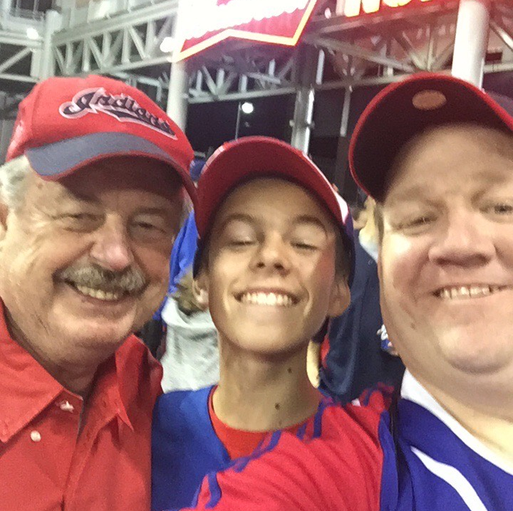
About Me

Slide 2
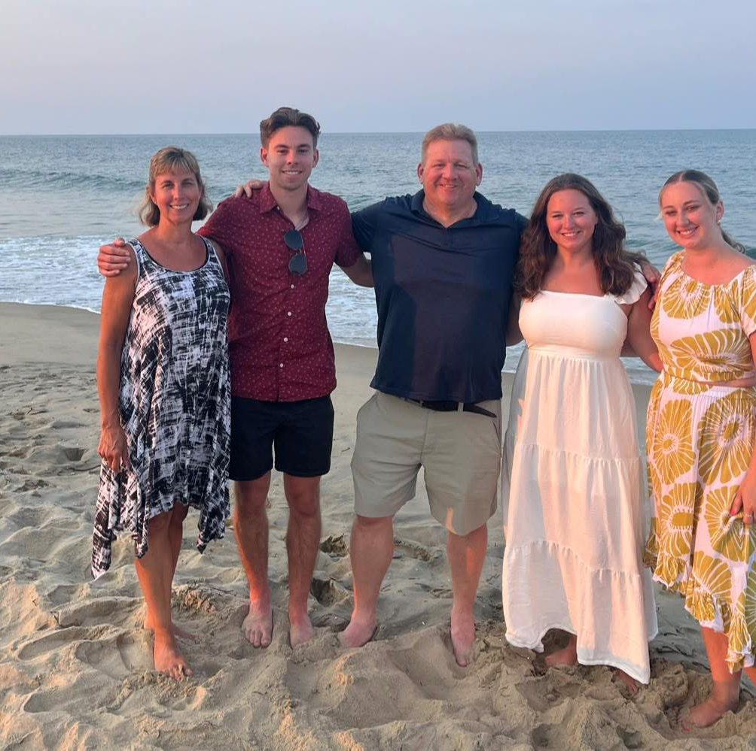
Family

Slide 3
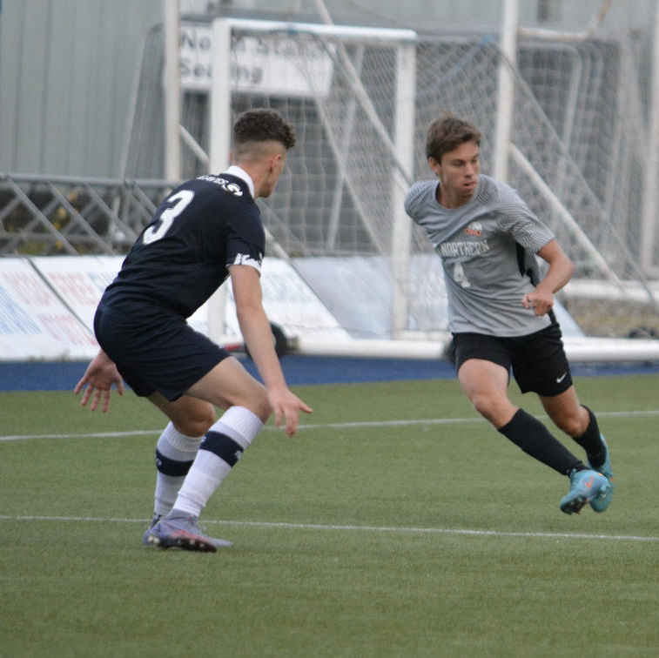
Undergraduate
Ohio Northern University
Major in Statistics
Minors in Computer Science, Data Analytics, and Business Analytics

Slide 4

Internship
Located in WPAFB, Dayton, OH
Contractor for DoD and DHS
Notes:
https://www.afit.edu/STAT/

Slide 5
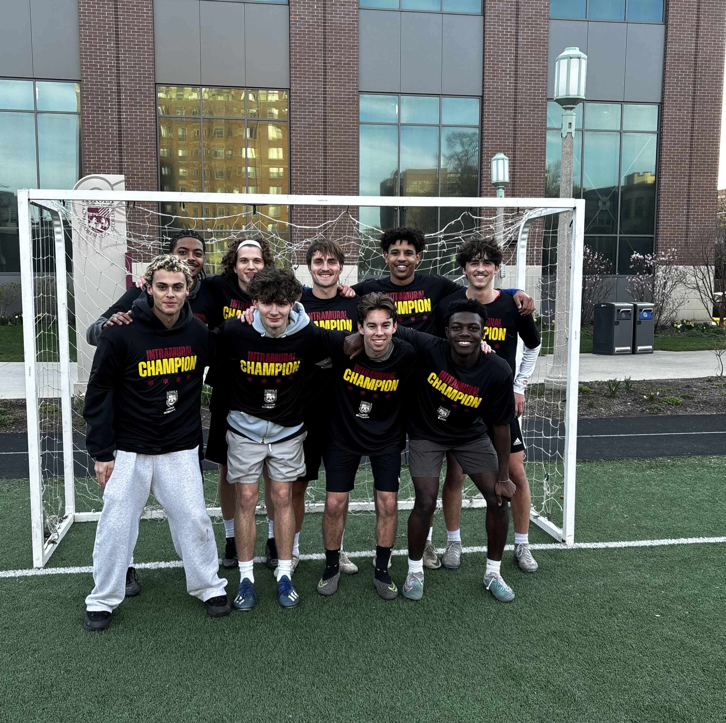
Current Events
Master’s in Applied Statistics
Research with Matthews

Slide 6
What’s Next?

